Slide 1

AI ENHANCED PLAGIARISM DETECTION USING ADAPTIVE NEURAL NETWORKS
Presentation by:
K. Chandrika Jyothirmai (22N01A0547)
B. Akhil Tej (22N01A0502)
Noor Saba (22N01A0535)
T. Vidhathri (22N01A0550)
M. Venkatesh (22N01A0514)
UNDER THE GUIDENCE OF :
Dr Khaja Ziauddin
Associate Professor

Slide 2
CONTENTS
ABSTRACT
INTRODUCTION
PROBLEM DEFINTION
EXISTING SYSTEM
PROPOSED SYSTEM
SOFTWARE AND HARDWARE REQUIREMENTS
MODULES
ARCHITECTURE
SYSTEM DESIGN
TESTING
RESULTS AND OUTPUT SCREENS
FUTURE ENHANCEMENT
CONCLUSION
REFERENCES

Slide 3
ABSTRACT
The Plagiarism detection plays a crucial role in academic integrity, content originality verification, and research publication security.
Plagiarism detection has become increasingly critical in academic, professional, and creative domains due to the vast amount of digital content generated daily.
Traditional plagiarism detection methods rely on keyword matching and similarity analysis
The adaptive neural network framework allows the system to learn and improve over time.
This project proposes an AI-enhanced plagiarism detection system using Adaptive Neural Networks, to identify copied content across diverse textual sources.

Slide 4
INTRODUCTION
Plagiarism is the act of using someone else's work, ideas, words, or intellectual property without proper acknowledgment, and presenting it as one's own.
Plagiarism detection has become an increasingly complex challenge in today’s digital landscape.
Conventional plagiarism detection tools often rely on lexical and syntactic analysis—comparing strings of text to identify overlaps or minor variations.
The proliferation of AI-driven content creation platforms has introduced new forms of plagiarism, including semantic rewriting, synonym substitution, sentence restructuring, and cross-lingual content transformation.
To overcome these limitations, artificial intelligence (AI) and Adaptive Neural Networks offer promising solutions.

Slide 5
PROBLEM DEFINITION
Plagiarism detection has grown more challenging with the rise of advanced manipulation techniques such as paraphrasing, synonym replacement, and cross-lingual translation.
These shortcomings affect the reliability and scalability of such systems in academic and professional use.
To overcome these limitations, there is a need for an AI-driven plagiarism detection system.
This approach enables accurate, context-aware detection of both exact and semantically similar content across large datasets.

Slide 6
EXISTING SYSTEM
Traditional plagiarism detection systems rely on:
Rule-based matching algorithms that fail against paraphrased content.
Limited contextual understanding, leading to false positives.
High computational costs for large-scale document comparison.
Lack of adaptability to evolving text modification techniques.

Slide 7
PROPOSED SYSTEM
The proposed AI-enhanced plagiarism detection system integrates adaptive neural networks to improve plagiarism identification. Key advantages include:
Context-aware plagiarism detection using transformer-based models.
Enhanced accuracy in detecting paraphrased and semantically similar content.
Scalable architecture for handling large document repositories.
Real-time plagiarism reporting with explainable AI-driven insights.

Slide 8
SOFTWARE AND HARDWARE REQUIREMENTS
Hardware Requirements :
• Processor : I3/Intel
• Processor Ram : 4 GB (min).
• Hard disk : 128 GB
• Key Board : Standard Windows Keyboard
• Mouse : Two or Three Button Mouse.
• Monitor : Any
Software Requirements:
• Operating System : Windows 7,10,11
• Server-side Script : Python.
• IDE : VS CODE.

Slide 9
MODULES
Text Preprocessing Module – Cleans and prepares input documents for analysis.
Semantic Feature Extraction Module – Uses models like BERT to generate text embeddings.
Adaptive Neural Network Detection Module – Compares embeddings for plagiarism detection.
Similarity Scoring and Reporting Module – Calculates and reports plagiarism scores based on detected similarity.

Slide 10
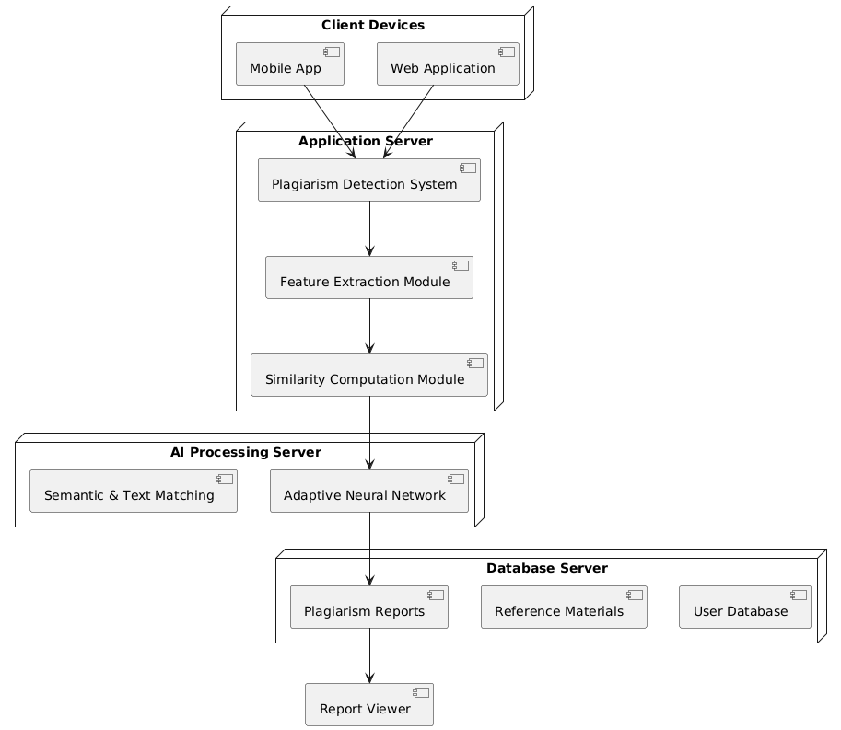
ARCHITECTURE OF PROPOSED SYSTEM

Slide 11
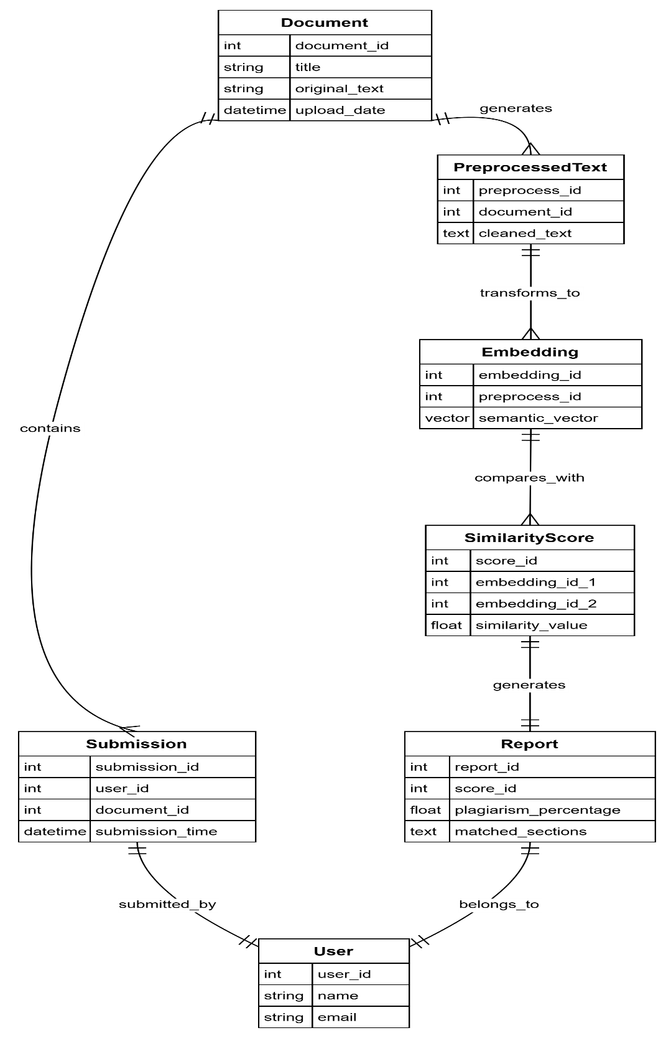
System design
Er diagram:

Slide 12
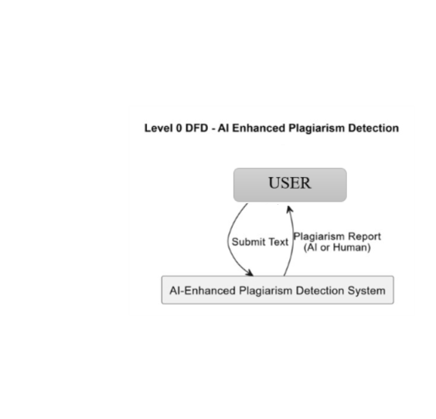
DATA FLOW DIAGRAM
LEVEL-0

Slide 13
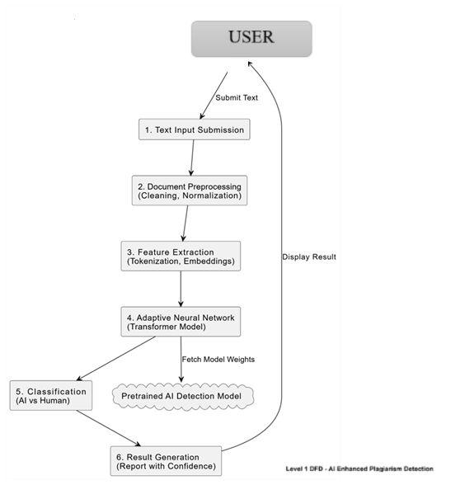
LEVEL-1

Slide 14
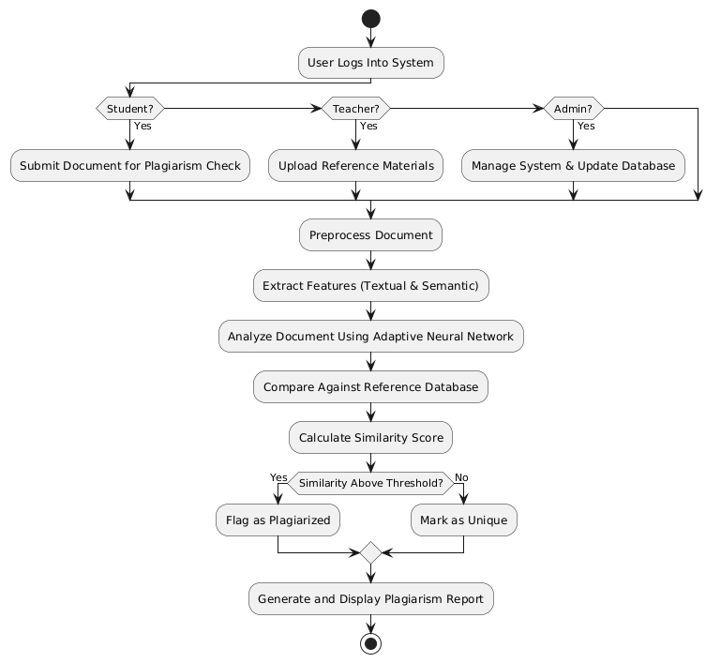
FLOW CHART

Slide 15
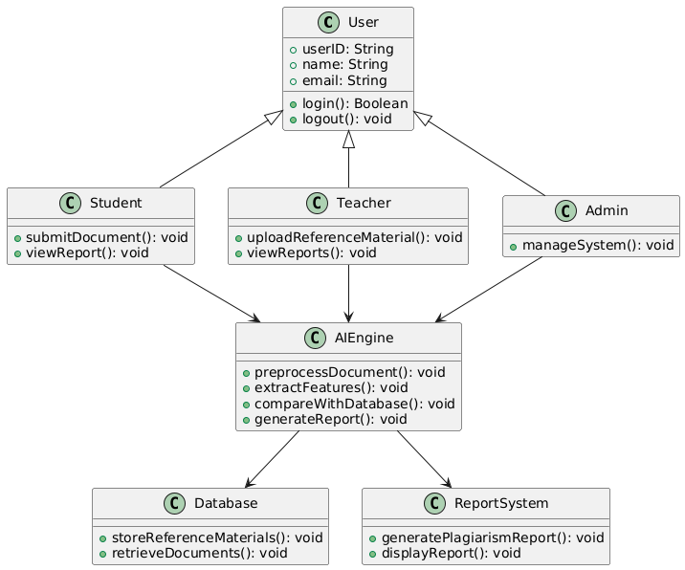
UML DIAGRAMS
CLASS DIAGRAM:

Slide 16
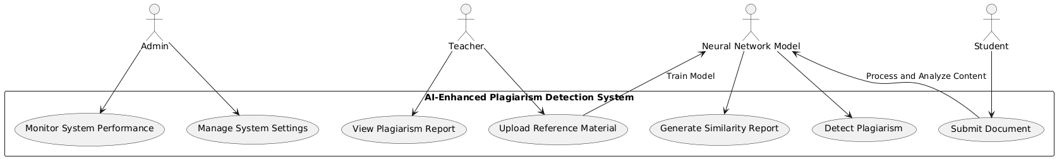
USE CASE DIAGRAM:

Slide 17
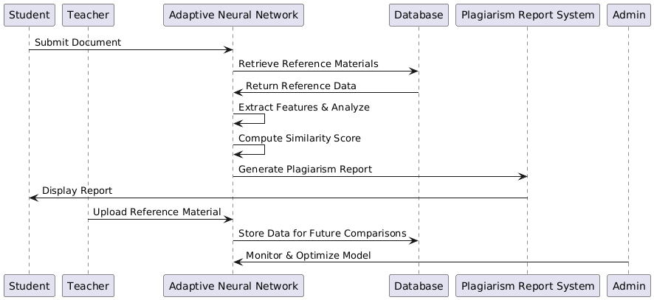
SEQUENCE DIAGRAM:

Slide 18
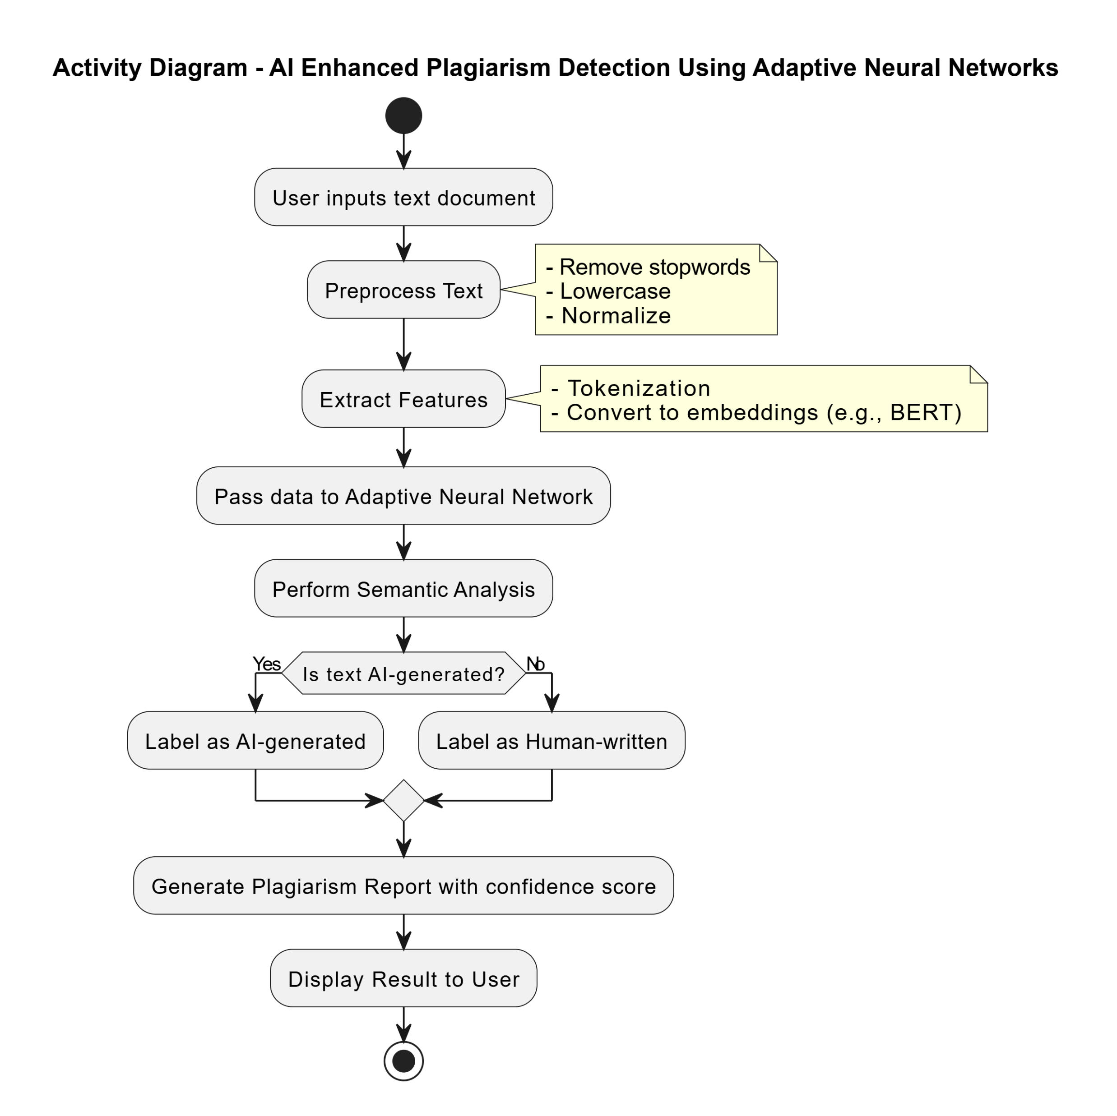
ACTIVITY DIAGRAM:

Slide 19
testing
It provides a way to check the functionality of components, sub assemblies, assemblies and/or a finished product.
Types of testing
1. Unit testing
2. Integration Testing
- Top Down Integeration
- BottomUp Integration
3. User Acceptance Testing
4. Output Testing
5.WhiteBox Testing
6.BlackBox Testing

Slide 20
Unit testing
Unit testing focuses on validating individual components or modules of the system to ensure their correct functionality before integration with other components. It is the foundational step in the testing process.
Purpose:
- To verify that each module works independently without errors.
- To identify bugs at the earliest stage of development, reducing future debugging efforts

Slide 21
Integration testing
Integration testing ensures that different modules or components of the system interact correctly after being combined. It focuses on verifying the data flow and functionality between integrated units.
Approaches Used:
Top-Down Integration
Bottom-Up Integration

Slide 22
User acceptance testing
Ensure the system meets user expectations and performs as intended.
Validates that the system is user-friendly and accessible, even for non-technical users.
Feedback from stakeholders is gathered to refine features and improve usability.

Slide 23
Output testing
Ensure the system generates accurate outputs in the required formats.
Validation of outputs against user-defined formats
Verified system outputs for accuracy, consistency, and completeness.

Slide 24
White box testing
Definition: Testing with knowledge of the internal workings, structure, and code of the software.
Ensure all possible paths and structures within the code are tested.
Helps identify hidden errors and optimize code.

Slide 25
Black box testing
Definition: Testing without any knowledge of the internal workings of the software.
It verifies that the software functions as expected based on the requirements.
Can be performed without knowledge of the code.

Slide 26
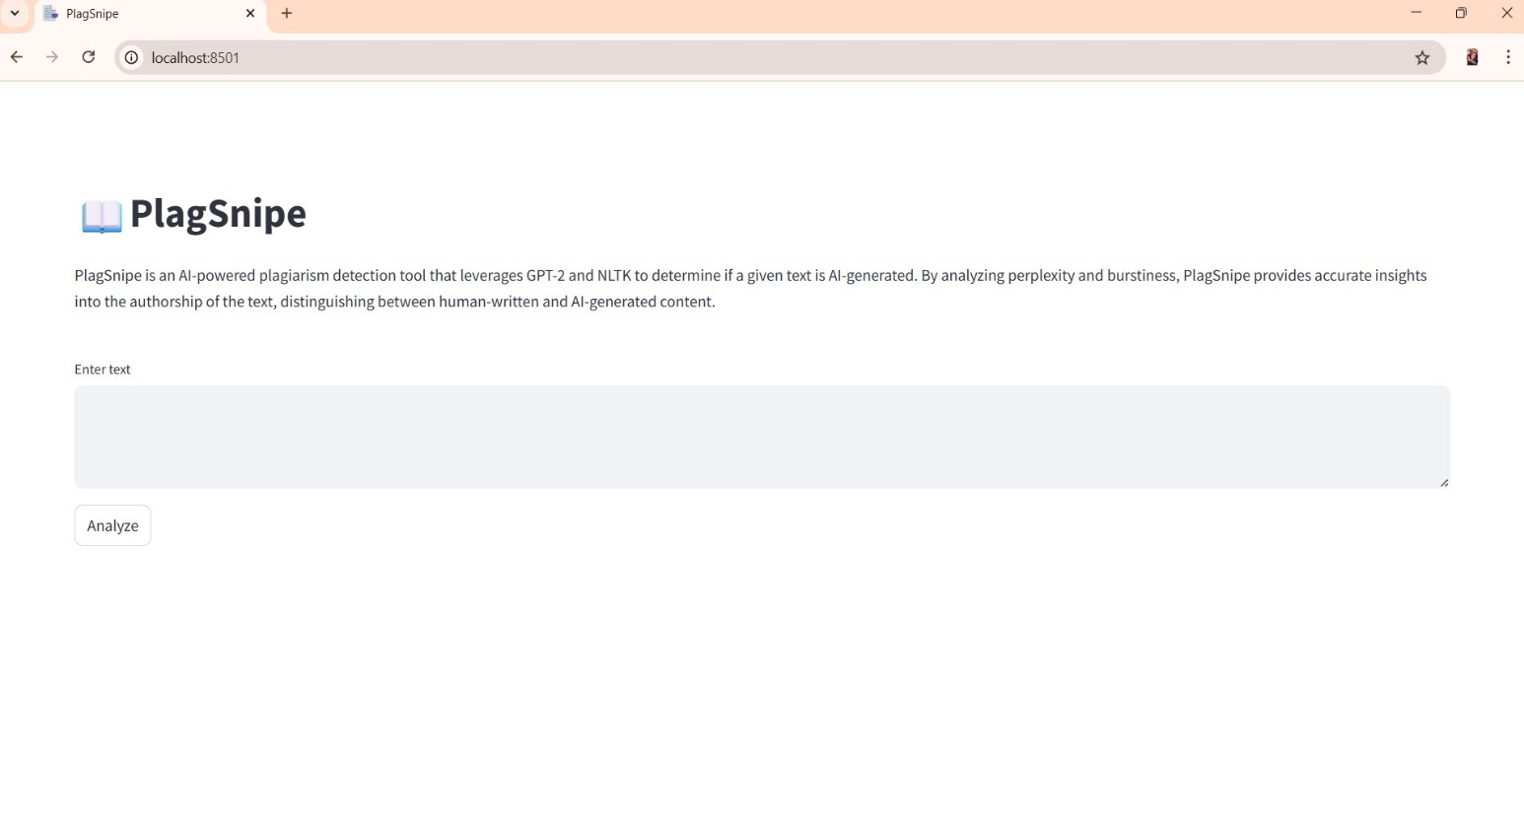
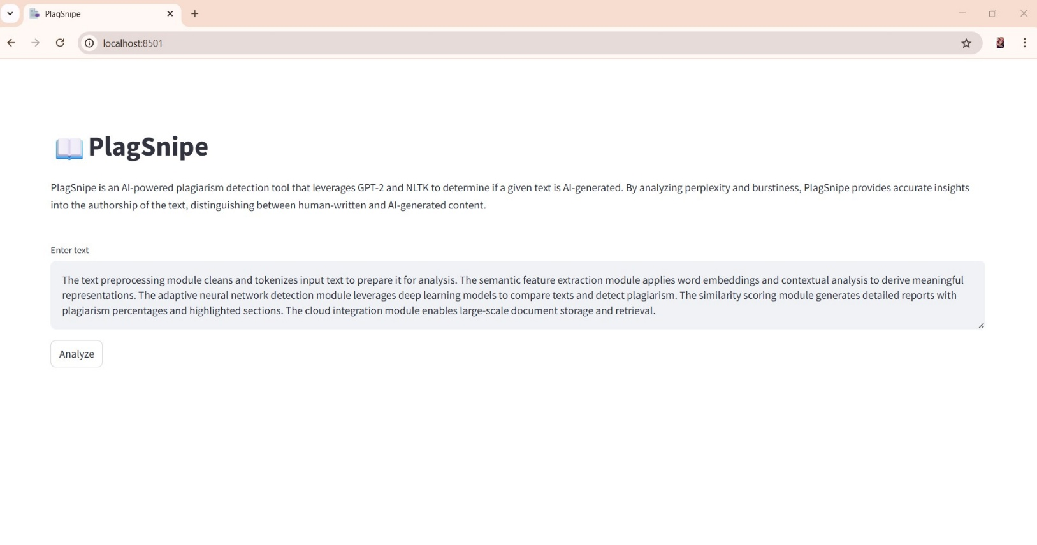
RESULT AND OUTPUT SCREENS:
Fig. Home Page
Fig. Sample Input 1

Slide 27
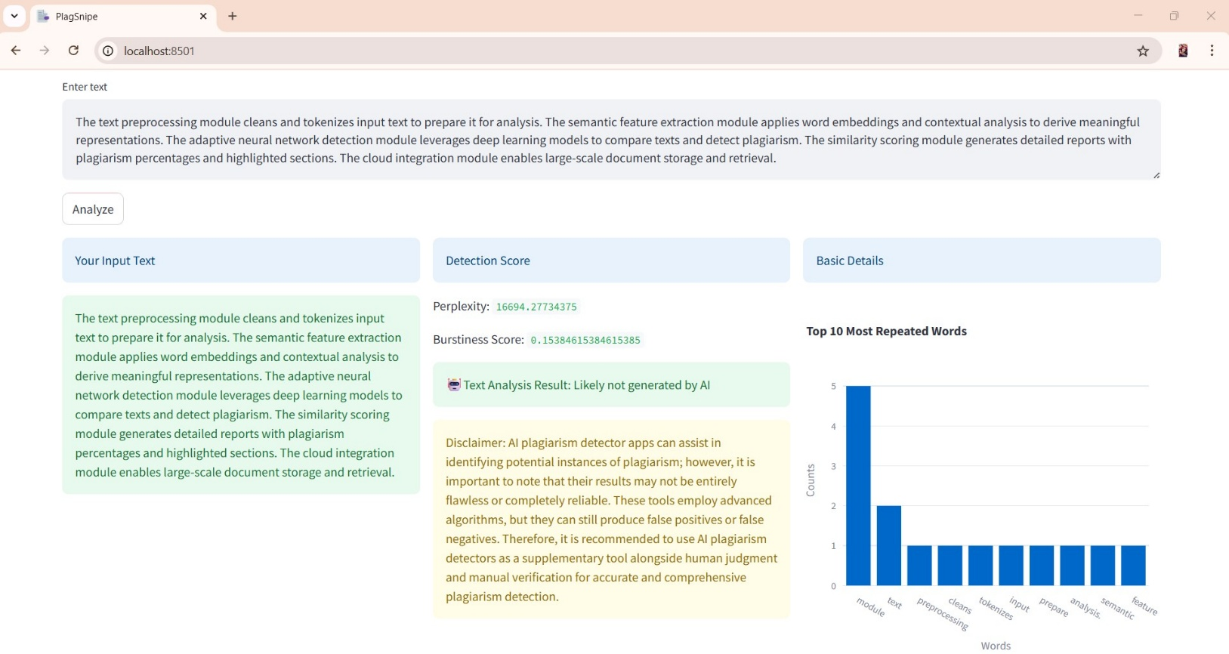
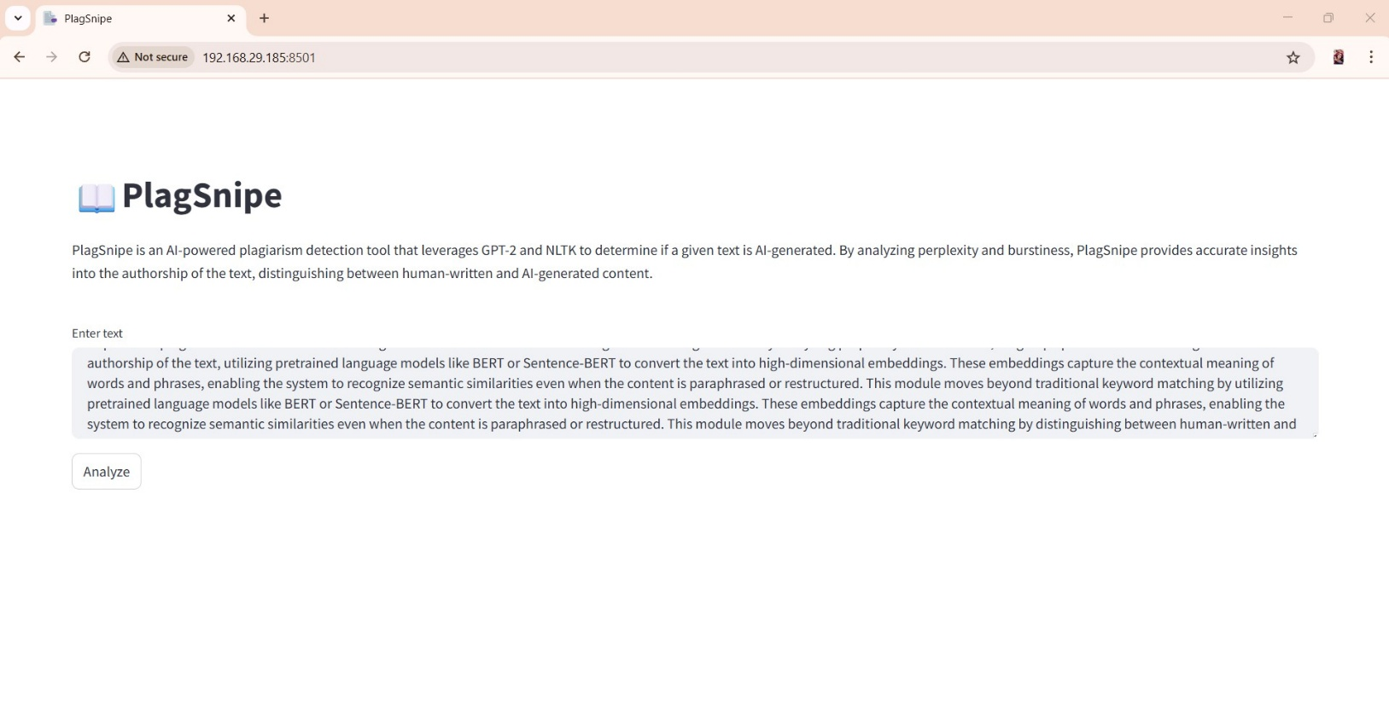
Fig. Result of Sample Input 1
Fig. Sample Input 2

Slide 28
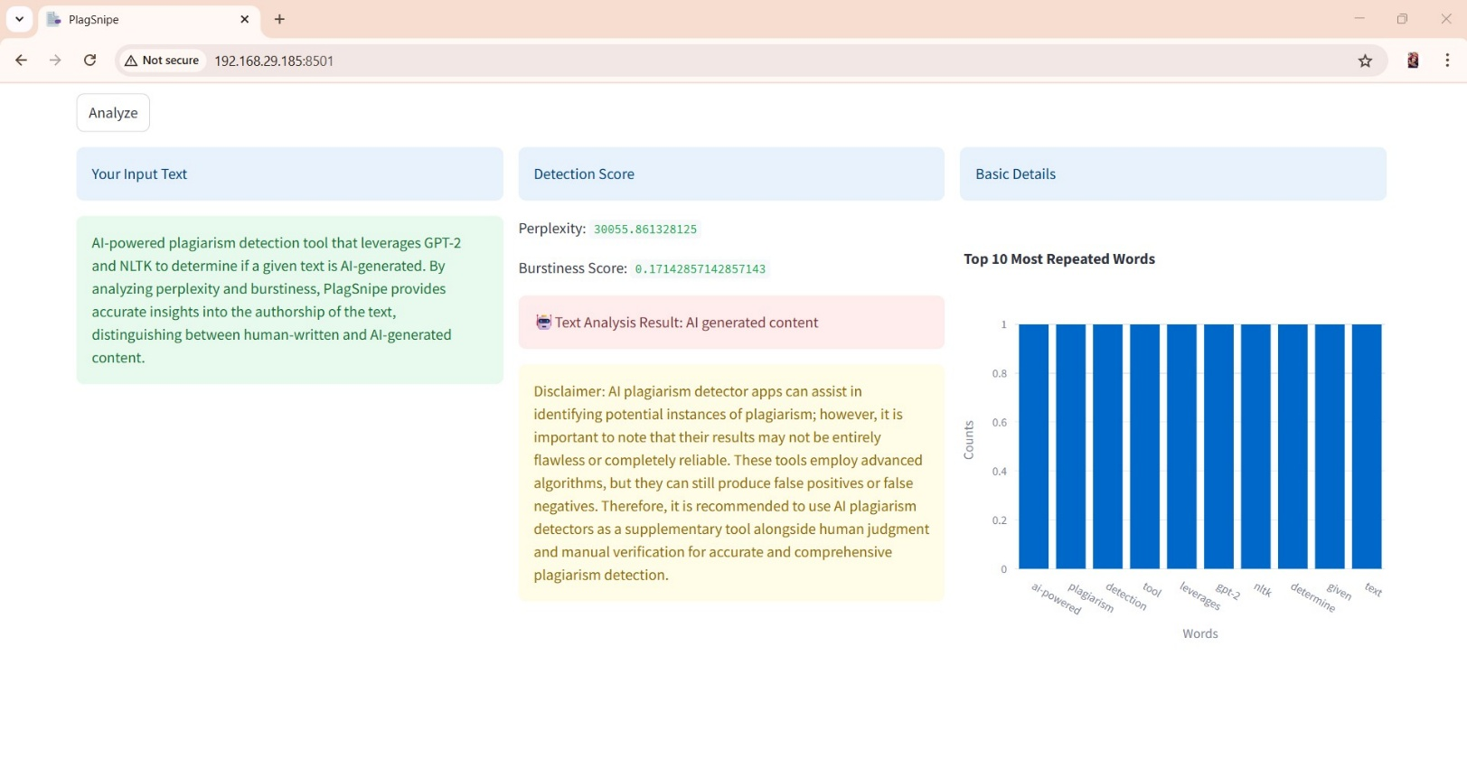
Fig. Result of Sample Input 2

Slide 29
FUTURE ENCHANCEMENT
there are several potential areas for future enhancement to further improve its accuracy, scalability, and usability.
One key enhancement could be the integration of multilingual support, enabling the system to detect plagiarism across documents written in different languages or translated content.
Another important direction is the development of a real-time plagiarism checking API that can be embedded into learning management systems (LMS), research submission platforms, or writing tools.
Finally, as user data and document repositories grow, enhancing data privacy and security measures

Slide 30
CONCLUSION
AI-Enhanced Plagiarism Detection Using Adaptive Neural Networks, offers a significant advancement over traditional plagiarism detection tools.
By utilizing pretrained language models such as BERT and transformer-based neural networks, the system captures rich semantic relationships between words and sentences.
This intelligent and scalable solution not only increases the accuracy and efficiency of plagiarism detection but also supports educational integrity.

Slide 31
REFERENCES
[1] S. Gupta and A. Kumar, "Deep Learning-Based Semantic Plagiarism Detection Using BERT Embeddings," International Journal of Computer Applications, vol. 182, no. 25, pp. 1–7, 2021.
[2] A. S. Razavi, F. T. Johari, and M. R. Selamat, "Adaptive Neural Network for Document Similarity in Plagiarism Detection," IEEE Access, vol. 8, pp. 13412–13423, 2020.
[3] M. Devlin, K. Chang, L. Lee, and K. Toutanova, "BERT: Pre-training of Deep Bidirectional Transformers for Language Understanding," in Proc. NAACL-HLT, 2019, pp. 4171–4186.
[4] Y. Zhang and M. Yang, "A Survey on Document Embedding Techniques in Plagiarism Detection," ACM Computing Surveys, vol. 53, no. 4, pp. 1–26, 2021.
[5] T. Mikolov et al., "Efficient Estimation of Word Representations in Vector Space," arXiv preprint, arXiv:1301.3781, 2013.
[6] S. Ramesh and V. Rajalakshmi, "Plagiarism Detection Using Siamese Neural Networks," in Proc. IEEE ICCIDS, 2020, pp. 39–44.

Slide 32
Thank you!!

